Slide 1
SQL Statements

Slide 2
SQL Statements
SQL commands are grouped into 4 main categories
DDL (Data Definition Language)
CREATE
ALTER
DROP
TRUNCATE
RENAME
DML (Data Manipulation Language)
INSERT
DELETE
UPDATE
SELECT
Notes:
SQL Commands are used to manipulate and retrieve records from the database.
SQL commands are not case sensitive.
All SQL commands must be ended with a semicolon.

Slide 3
TCL (Transaction Control Language)
COMMIT
ROLLBACK
SAVEPOINT
DCL (Data Control Language)
GRANT
REVOKE

Slide 4
Naming Rules
Table and Column names should begin with a letter and may have numeric digits.
The length cannot exceed more than 30 characters.
It must contain only A-Z, a-z, 0-9 and special characters like _ , $ and #
Names must not be a Oracle keyword.
No two tables can have the same name owned by the same user.

Slide 5
Tell me why?
Why is table name restricted to only 30 characters?
Oracle stores all these named structures in the data dictionary.
And the data dictionary has the size restricted to 30 characters

Slide 6
Data Definition Language
DDL (Data Definition Language)
DDL commands are used in creating, making modifications, dropping the database objects.
CREATE command is used to create a new database object like table, View, Sequence etc.
To create a database object, say table, the user must have the CREATE TABLE privilege

Slide 7
Create Table
Syntax:
CREATE TABLE [schema name] tablename
(columnname datatype [DEFAULT expr] [, …] );
Specify the schema name in which the table has to be created. If omitted, the schema name will be same as that of the user’s account.
Specify the name of the table to be created.
Specify one or more names of the column along with the data types.
DEFAULT clause is used to specify a value to be assigned to that column in case a value is not entered.
The data type of the default expression must match the data type of the column.

Slide 8
Example
Create a table Student with the columns stuid with 4 digit , student name , class, registration date by setting it to default current system date.
CREATE TABLE student (stuid NUMBER(4),stname VARCHAR2(10),class NUMBER(4) DEFAULT 1 ,reg_date DATE DEFAULT SYSDATE);
SYSDATE an Oracle predefined function that returns current system date and time.
We will see more functions in later sessions

Slide 9
Viewing table structures
To view the table structure we use a SQL command
SQL> DESCRIBE table_name;
or SQL> DESC table_name
It shows the column names and the data types associated with them.
To view all the tables owned by the owned by the current user
SQL> SELECT table_name FROM USER_TABLES;
To view all the columns in a particular table
SQL> SELECT column_name FROM USER_TAB_COLUMNS WHERE table_name='STUDENT';
All the names are stored in UPPER case in the data dictionary. Hence when we are looking for a table name we must use upper case in the query.

Slide 10
Exercise
Create a table Salary_Det with the following fields:
Column name | Description | Description | Default
Empid | Maximum of 30 characters | Employee ID | None
Basic | 6 digits before decimal and 2 after | Basic pay | -1
Hra | 5 digits before decimal and 2 after | House Rent | -1
Doj | DATE | Date of Joining | Today’s date
Remarks | VARCHAR2(20) | Any Notes | None
15 mins

Slide 11
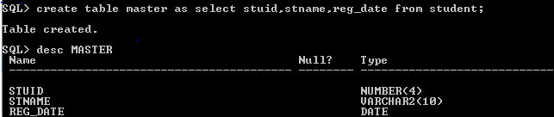
Table creation using a subquery
In cases where we need to create a table that has same structure as another table in the database, we can use the syntax specified below:
Syntax:
CREATE TABLE tablename[(Column_name1,
Column_name2…)] AS Subquery;
Example:
SQL> CREATE TABLE master AS
SELECT stuid,stname,reg_date FROM student;

Slide 12
Changing the existing table
Syntax:
ALTER TABLE tablename ADD/MODIFY/DROP
COLUMN Column_name datatype [DEFAULT value];
Specifies the table name to be altered.
The ADD column clause is used to add a new column to the table.
The MODIFY clause is used to modify the properties of the existing column.
The DEFAULT clause is used to provide default value for the columns.
The DROP clause is used to drop the column name that is no longer needed.
Notes:
If the table is empty, then we can increase or decrease the column width.
If not, we can only increase the column value.

Slide 13
Examples
Add a column called course of character 10 bytes to the existing table student.
SQL> ALTER TABLE student ADD course VARCHAR2(10);
Modify the column course of character 10 bytes to 20 bytes in the existing table student.
SQL> ALTER TABLE student MODIFY course VARCHAR2(20);
Drop the column reg_date from the existing student table.
SQL> ALTER TABLE student DROP COLUMN reg_date;

Slide 14
Activity
Product table was created “2. SQL Concepts” session.
Check and make sure the table exist and note the column and their datatypes.
Check and make sure the table has data.
Change the column Qty to NUMBER(3)
Change the column Pname to NUMBER(3)
What do you conclude?
Notes:
We can change the datatype of the column provided the column is empty.

Slide 15
Deleting a table
Syntax:
DROP TABLE tablename ;
Used to drop the entire table.
All the records and the structure of the table will be lost
Example:
SQL> DROP TABLE student;

Slide 16
Truncate Table
Syntax:
TRUNCATE TABLE tablename;
Removes all the records from the table.
Only the structure of the table remains
We cannot get back (rollback) the deleted records.
Releases the storage space used by the table.
Example:
SQL> TRUNCATE TABLE sales;

Slide 17
Renaming a table
Syntax:
RENAME TABLE tablename TO new_tablename ;
Used to provide a new name to the existing table.
This new table name will overwrite the previous table name.
Example:
SQL> RENAME TABLE student TO stud;

Slide 18
Exercise
Create a new table called Salary similar to Salary_Det
Change the table to add a default for Doj as 1st March 2010.
Remove defaults for Basic and HRA.
Remove the column “Remarks”.
Add a column EName that can have hold at most 30 characters and Gender with just one character and set the default gender to ‘M’.
Remove the Salary_Det table from the database.
Change the table name Salary into Salary_Det.
(15 mins)

Slide 19
Data Manipulation Language
DML (Data Manipulation Language)
Add new rows to a table by using INSERT.
Modify existing rows in a table by using UPDATE.
Removing existing rows from the table using DELETE.
Selecting specific columns or all columns using SELECT.

Slide 20
Adding rows in a table
Syntax:
INSERT INTO table_name[(column [, column…. ] )]
VALUES(values [, values …..] );
INSERT is used to add one or more new records into the table.
The VALUES clause is used to assign values to the corresponding columns in the column list.
The columns can be listed in any order as long as the values in the VALUES clause are also in the same order. If columns are not specified, then all the columns are assumed. In such case, the order in which the values are entered must ne maintained.
Character data type values and Date values must be enclosed in single quotation mark. Numeric values need not be enclosed in quotes.

Slide 21


Examples on Insert
Insert a record in student table.
SQL> INSERT INTO Student VALUES(1234,'Beena',2 ,'1-MAR-2010')
Insert only 2 fields
SQL> INSERT INTO Student(stuid, stname) VALUES(2345,'Vikram');
SQL> INSERT INTO Student(class,stname) VALUES(2,'Ravi')
Look at the query above. How is it that data for the columns “CLASS” and “REG_DATE” has values in the 2nd row even though we have not entered?

Slide 22
Tell me how
The query select * from student where stuid=''; does not return any rows. How to find rows that has no data?
No data does not mean ‘’ or 0 for a character type of data or numeric type of data respectively.
No data is represented in a database using NULL.
select * from student where stuid is NULL;
returns the desired row.

Slide 23
Adding NULLs
In cases where we want to explicitly enter a NULL, we can specify it explicitly in the INSERT statement like the example below.
INSERT INTO Student VALUES(3456, 'Kavita', NULL, NULL);
Or
INSERT INTO Student(stuid, stname, class) VALUES(4567, 'Kartik', NULL);

Slide 24
INSERT statement with a sub-query
It is possible to insert data from an existing table using a SELECT clause in the INSERT statement.
The VALUES clause is omitted.
Example:
Suppose data into the Master table from Student table following query can be used
SQL> INSERT INTO master(stuid, stname, Reg_date) SELECT stuid,stname,reg_date FROM student
Data can also be filtered using WHERE clause.

Slide 25
Insert multiple records
INSERT ALL statement is used to insert multiple records simultaneously.
INSERT ALL
INTO table_name VALUES <column_name_list)
INTO table_name VALUES <column_name_list)
...
INTO table_name VALUES <column_name_list)
SELECT Statement;
Note that the SELECT row must return only one row. If it returns multiple rows then the whole of INSERT statement will execute as many times as the number of records the SELECT returns.
SELECT clause is compulsory. So, if we don’t want to use it, we must have SELECT * FROM DUAL;
DUAL is a dummy table present by default in all Oracle databases.
Notes:
DUAL is a dummy table with a single column DUMMY (VARCHAR2(1) ) present by default in all Oracle database installations.

Slide 26
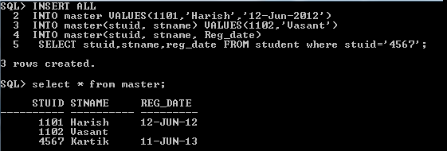
Example
Inserting records in the master table.
Before that let us delete all the data in the table.
What is the command to delete all the data in the table?
SQL> INSERT ALL
2 INTO master VALUES(1101,'Harish','12-Jun-2012')
3 INTO master(stuid, stname) VALUES(1102,'Vasant')
4 INTO master(stuid, stname, Reg_date)
5 SELECT stuid,stname,reg_date FROM student where stuid='4567';

Slide 27
Exercise
Salary_Det
Empid | Ename | Basic | Hra | Doj | Gender
EA12345 | Geetha S | 50000 | 1000 | 10-7-2010 | F
EA23456 | Hari Prasad | 40000 | 1000 | 31-6-2011 | M
EA34567 | Jayganesh |  |  | 7-4-2009 | M
SAP1234 | Mohan V |  |  | 6-12-2009 | M
SAP2345 | Sudha N | 30000 | 750 |  | F
Enter the following records in the Salary_Det table using INSERT ALL.
Create another table called Salary_DetF with similar structure as Salary_Det.
Insert data with Gender as F into Salary_DetF. (30 mins)

Slide 28
Modifying the data
Syntax:
UPDATE table_name SET column_name = value
[WHERE condition] ;
UPDATE is used to modify the values in some specified columns in the table.
The column can be updated for a row or more than one row.
The column name must be present in the referenced table.
The SET clause assigns the value to the column identified by the column name.
The WHERE clause is used to filter the records while updating the records depending on the condition specification.
On omission of WHERE clause, all the rows will be updated.

Slide 29
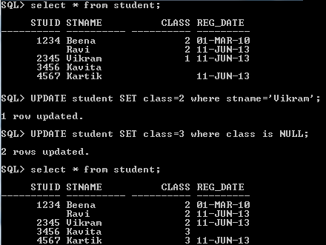
Examples on UPDATE
SQL> UPDATE student SET class=2 where stname='Vikram';
SQL> UPDATE student SET class=3 where class is NULL;

Slide 30

Delete table
Syntax:
DELETE FROM tablename [WHERE condition];
Used to remove the records from the table.
If WHERE clause is omitted, then all the records will be deleted from the table.
Presence of WHERE clause helps in deleting only the specific records based on the condition.
Example:
SQL> DELETE FROM student WHERE stuid is NULL;
Note that if you want to delete all records use TRUNCATE as is faster than DELETE.

Slide 31
Exercise
Make Doj of Jayganesh as 1 Jul 2013 and salary as 100000.
Modify the Salary_Det table’s Hra such that it is 5% of Basic.
Increase the Basic salary by Rs.5000 for women who joined before 2011.
Delete records where Basic or Doj is null.
(20 mins)

Slide 32
Revisiting SELECT statement
Syntax:
SELECT Column1 [, Column2,…]
FROM Table1 [, table 2….]
[ WHERE conditions]
[ GROUP BY column1 [,Column2…]
[ HAVING condition]
[ORDER BY column1 [,Column2…]]
As we have seen briefly, SELECT clause is used to extract / query data from one or more tables.
Arithmetic (+,-,*,%) can be applied to the SELECT clause.
For example: SELECT 5*7 + 3 FROM DUAL;

Slide 33
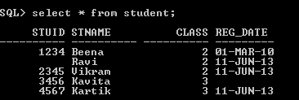
Some sample Queries
Add STUID and CLASS for each record: SELECT stuid+class FROM student;
Concatenate student name and the their class SELECT stname||'-'|| class FROM student
Find all the names of all the students who have been given REG_DATE.
SELECT stname FROM student where reg_date is not null;
Notes:
We created the student table and inserted some data into it in this session. Currently when we query the student table using SELECT all, these are the records. We will use this table to query further.

Slide 34
ORDER BY
ORDER BY causes the result of the query to be displayed in a specific order (ascending or descending) based on the one or more attributes.
ASC or DSC can be added to the ORDER BY causes to specify the direction of sort. By default the sort order is ASC.
Example:
Display the student records sorted by student names
SELECT * FROM student order by stname;
Display students who in the order of higher to lower classes and have valid registration date.
SELECT * FROM student where reg_date IS NOT NULL ORDER BY class DESC;

Slide 35
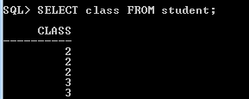
DISTINCT/UNIQUE
DISTINCT is used to eliminate duplicate rows.
Example: List out the classes where we have students.
Note that SELECT * will return duplicates.
SELECT UNIQUE class FROM student;
Or
SELECT DISTINCT class FROM student;
Standard

Slide 36
Counting records
COUNT is an aggregate function that help in counting number of records.
Examples:
Find the total number of students enrolled. SQL> SELECT COUNT(*) FROM student;
Find total number of classes for which students have been enrolled.
SQL> SELECT COUNT(DISTINCT class) FROM student;

Slide 37
Exercise
Empid | Ename | Basic | Hra | Doj | Gender
EA12345 | Geetha S | 55000 | 2750 | 10-7-2010 | F
EA23456 | Hari Prasad | 40000 | 2000 | 31-6-2011 | M
EA34567 | Jayganesh | 100000 | 5000 | 1-7-2013 | M
SAP1234 | Mohan V |  |  | 6-12-2009 | M
Using the Salary_Det table write the queries to find the following :
Compute and display name and travel allowance which is 2% of Basic for the employees whose basic is given. Display the result in sorted order of name and travel allowance.
Count the number of employees who have the gross salary (basic+hra) greater than 60000.
(30 mins)

Slide 38
Activity
Try out the following queries
SELECT Null / 4*9+6 from DUAL;
SELECT Null||’ORACLE’ from DUAL;
SELECT ‘Null’||’ORACLE’||’SQL’ from DUAL;
SELECT DISTINCT class, stname FROM student order by class;
SELECT DISTINCT reg_date FROM student;

Slide 39
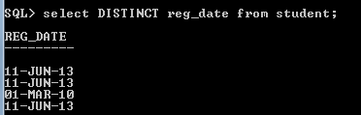
Tell me why
Why does the query not return distinct dates?
If you recall, Oracle internally stores data in the form of year, month, day, hours, minutes and seconds. If you have not explicitly entered the time components, the time components of the system at the time of entry of data is taken. Hence each reg_date is distinct because there is some change in the time components.
To display distinct dates we need to use oracle function to_char() about which we will learn in a later session.

Slide 40
Transaction Control Language
A logical unit of work may comprise of either on or more DML statements.
For instance, creating a employee may need insertion into one or more tables like login table and employee table etc.
It is important that a database ensures that all DML statements in a logical unit of work is either done completely or is not done at all.
Oracle and other RDBMS system allows us to define what are called Transactions, which is a grouping of DML statements to form a logical unit of work.
The SQL statements in the Transaction are either all committed or all rolled back.
Every transaction executed in the Oracle database has an unique Transaction ID.

Slide 41
ACID properties
There are 4 properties of transactions that a RDBMS must ensure to maintain data in face of concurrent access and system failure.
These properties are called ACID properties.
Atomicity: A transaction’s changes to a state are atomic; either they all happen or none happens.
Consistency: A transaction is a correct transformation of state. The action taken as a group do not violate any integrity constraints with that state.
Isolation: Many transaction may be executing concurrently, but from any given transaction ‘s point of view, other transaction appear to have executed before or after its own execution.
Durability: Once a transaction completes successfully, the changes to the state are made permanent and survive any subsequent failures.

Slide 42
COMMIT and ROLLBACK
Syntax:
COMMIT WORK; or
COMMIT;
Used to make all the changes permanent that were performed during the transactions.
Issuing a commit at the end of transactions saves the data permanently to the database.
Commit marks the end of the transaction.
Syntax:
ROLLBACK;
Used to reverse all or some of the database changes made during the transactions.

Slide 43
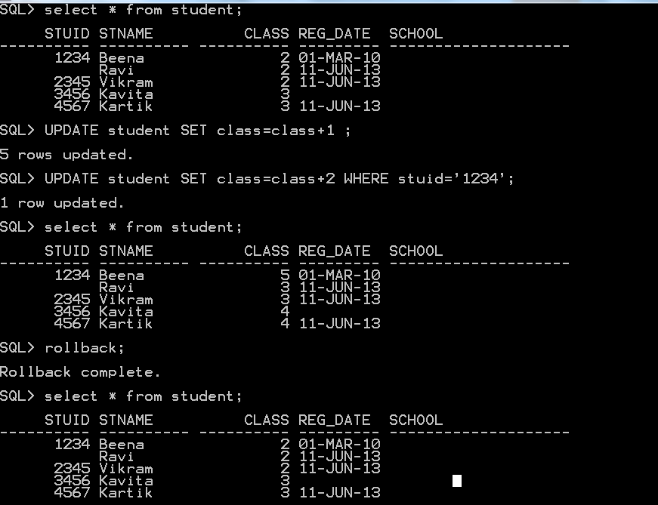
Example: COMMIT and ROLLBACK
Notes:
DDL statements are Auto-committed and permanently saved to the database.
DML statements can be rolled back.

Slide 44
SAVEPOINT
Note that when we issue COMMIT or ROLLBACK in the previous example, all the statements that were issues before the last COMMIT or ROLLBACK become part of the transaction.
Syntax:
SAVEPOINT savepoint_name;
COMMIT/ROLLBACK TO savepoint_name;
Used as a marker to identify the point up to which the transaction can be rolled back (from the last issued DML statement).
In other words, a transaction begins implicitly with the first statement issued since the last COMMIT or ROLLBACK or continues after a ROLLBACK TO SAVEPOINT.
Notes:
If two savepoints are created with the same name, then the previously declared savepoint will be erased.

Slide 45
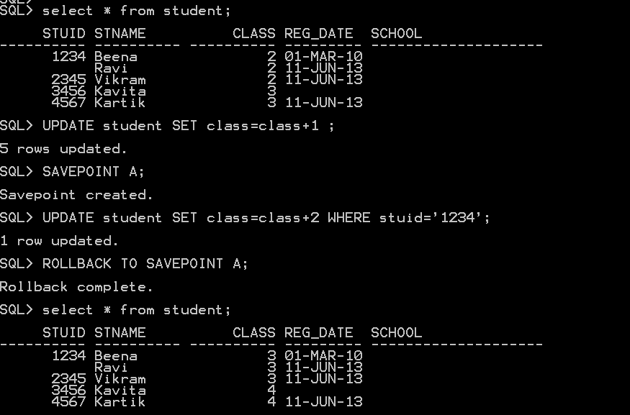

Slide 46
Activity
Are DDL statements auto-commit? Find out.

Slide 47
Data Control Language
DCL statements are about giving user access to the database objects.
It enforces security to the database.
GRANT & REVOKE are the only statements that constitute DCL.
These privileges are given by the Database Administrator (DBA)
There are 2 types of Privileges
System Privileges – This allows the user to Create, Alter and Drop the database objects. They are fundamentally DDL operations permissions
Object Privileges - This allows the user to Select, Insert, Update or Delete database objects i.e., DML operation permissions

Slide 48
System privilege
GRANT system-privilege [,system-privilege,…] TO username|rolename [,username|rolename]|PUBLIC [WITH ADMIN OPTION];
System-privilege are:
CREATE [ANY] TABLE/VIEW/INDEX/TRIGGER/PROCEDURE
ALTER [ANY] TABLE/TRIGGER/PROCEDURE
DROP [ANY] TABLE/VIEW/INDEX/TRIGGER/PROCEDURE
SELECT/INSERT/UPDATE/ DELETE [ANY] TABLE
CREATE SESSION
EXECUTE ANY PROCEDURE

Slide 49
Examples
Let us say that there is a user called mary
DBA can grant privilege to mary to connect to Oracle database.
SQL> GRANT CREATE SESSION TO mary
Grant succeeded.
Connect to mary and try to access student table.
SQL> CONNECT mary/mary
Connected.
SQL> select * from system.student;
…
ERROR at line 1:
ORA-00942: table or view does not exist
But cannot access any table

Slide 50
Object privilege
GRANT object-privilege|ALL [, (columnname), object-privilege (columnname)] ON objectname TO user-name|rolename [,user-name|rolename] |PUBLIC [WITH GRANT OPTION];
Object name are table name, view name, procedure or function name
Object-privilege are:
INSERT,SELECT, UPDATE, DELETE, for tables and views.
ALTER,INDEX,REFERENCES for tables,column name
EXECUTE for procedures and functions
Notes:
Roles:
Roles are collection or groups of privileges that can be granted to users.
When there are many database users, Roles are very useful in granting access.
It saves lot of time and effort.
Example:
SQL> CREATE ROLE cust_role;
SQL> GRANT SELECT, INSERT, UPDATE, DELETE ON customers TO cust_role;
Thus this cust_role can be given to one / many users.
SQL> GRANT cust_role TO Scott, Admin;
We can also Revoke the privileges from the roles.
SQL> REVOKE INSERT, UPDATE FROM cust_role;

Slide 51
Example
Grant SELECT privilege on Student table to mary.
GRANT SELECT ON student TO mary;
Connect to mary and try to access Student table.
SQL> CONNECT mary/mary
Connected.
SQL> select * from system.student;
List of students displayed
Grant execute privilege to mary such that she can give this privilege to any other user.
SQL> GRANT EXECUTE ANY PROCEDURE TO mary WITH ADMIN OPTION;

Slide 52
Revoke privilege
Syntax:
REVOKE privilege_name ON object_name
FROM user_name|PUBLIC|role_name;
Used to remove access on database objects from other users.
Example:
SQL> REVOKE SELECT ON student FROM mary;

